Slide 1
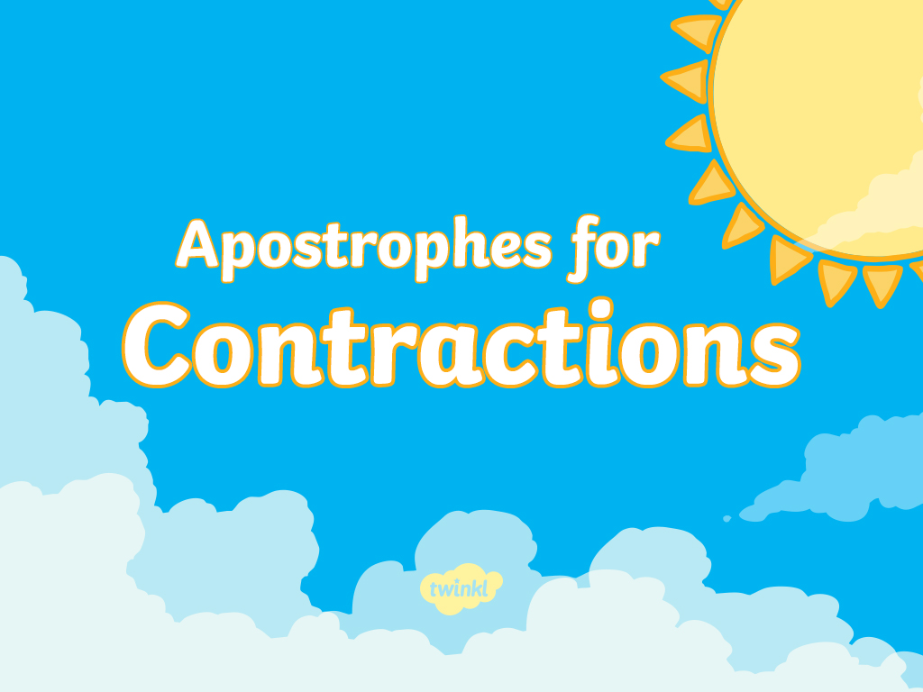

Slide 2

This is the Squeeze-O-Matic 100. It squeezes two words together and takes out a letter (or letters) to make one shorter word. Here are the words that go into the Squeeze-O-Matic. Can you write down the words that should come out?
are not
he had
she will
I have
aren’t
he’d
she’ll
I’ve
Can you write a sentence using each of the words that have come out of the Squeeze-O-Matic?

Slide 3
Oh no! The Squeeze-O-Matic 100 just broke! The words are going in the wrong way. Can you help fix the machine by writing the two correct words for each of the short, squeezed words?
doesn’t
they're
does not
they are
we have
you are
you're
we've
Can you write a sentence using each of the words that have come out of the Squeeze-O-Matic?
Show answers

Slide 4
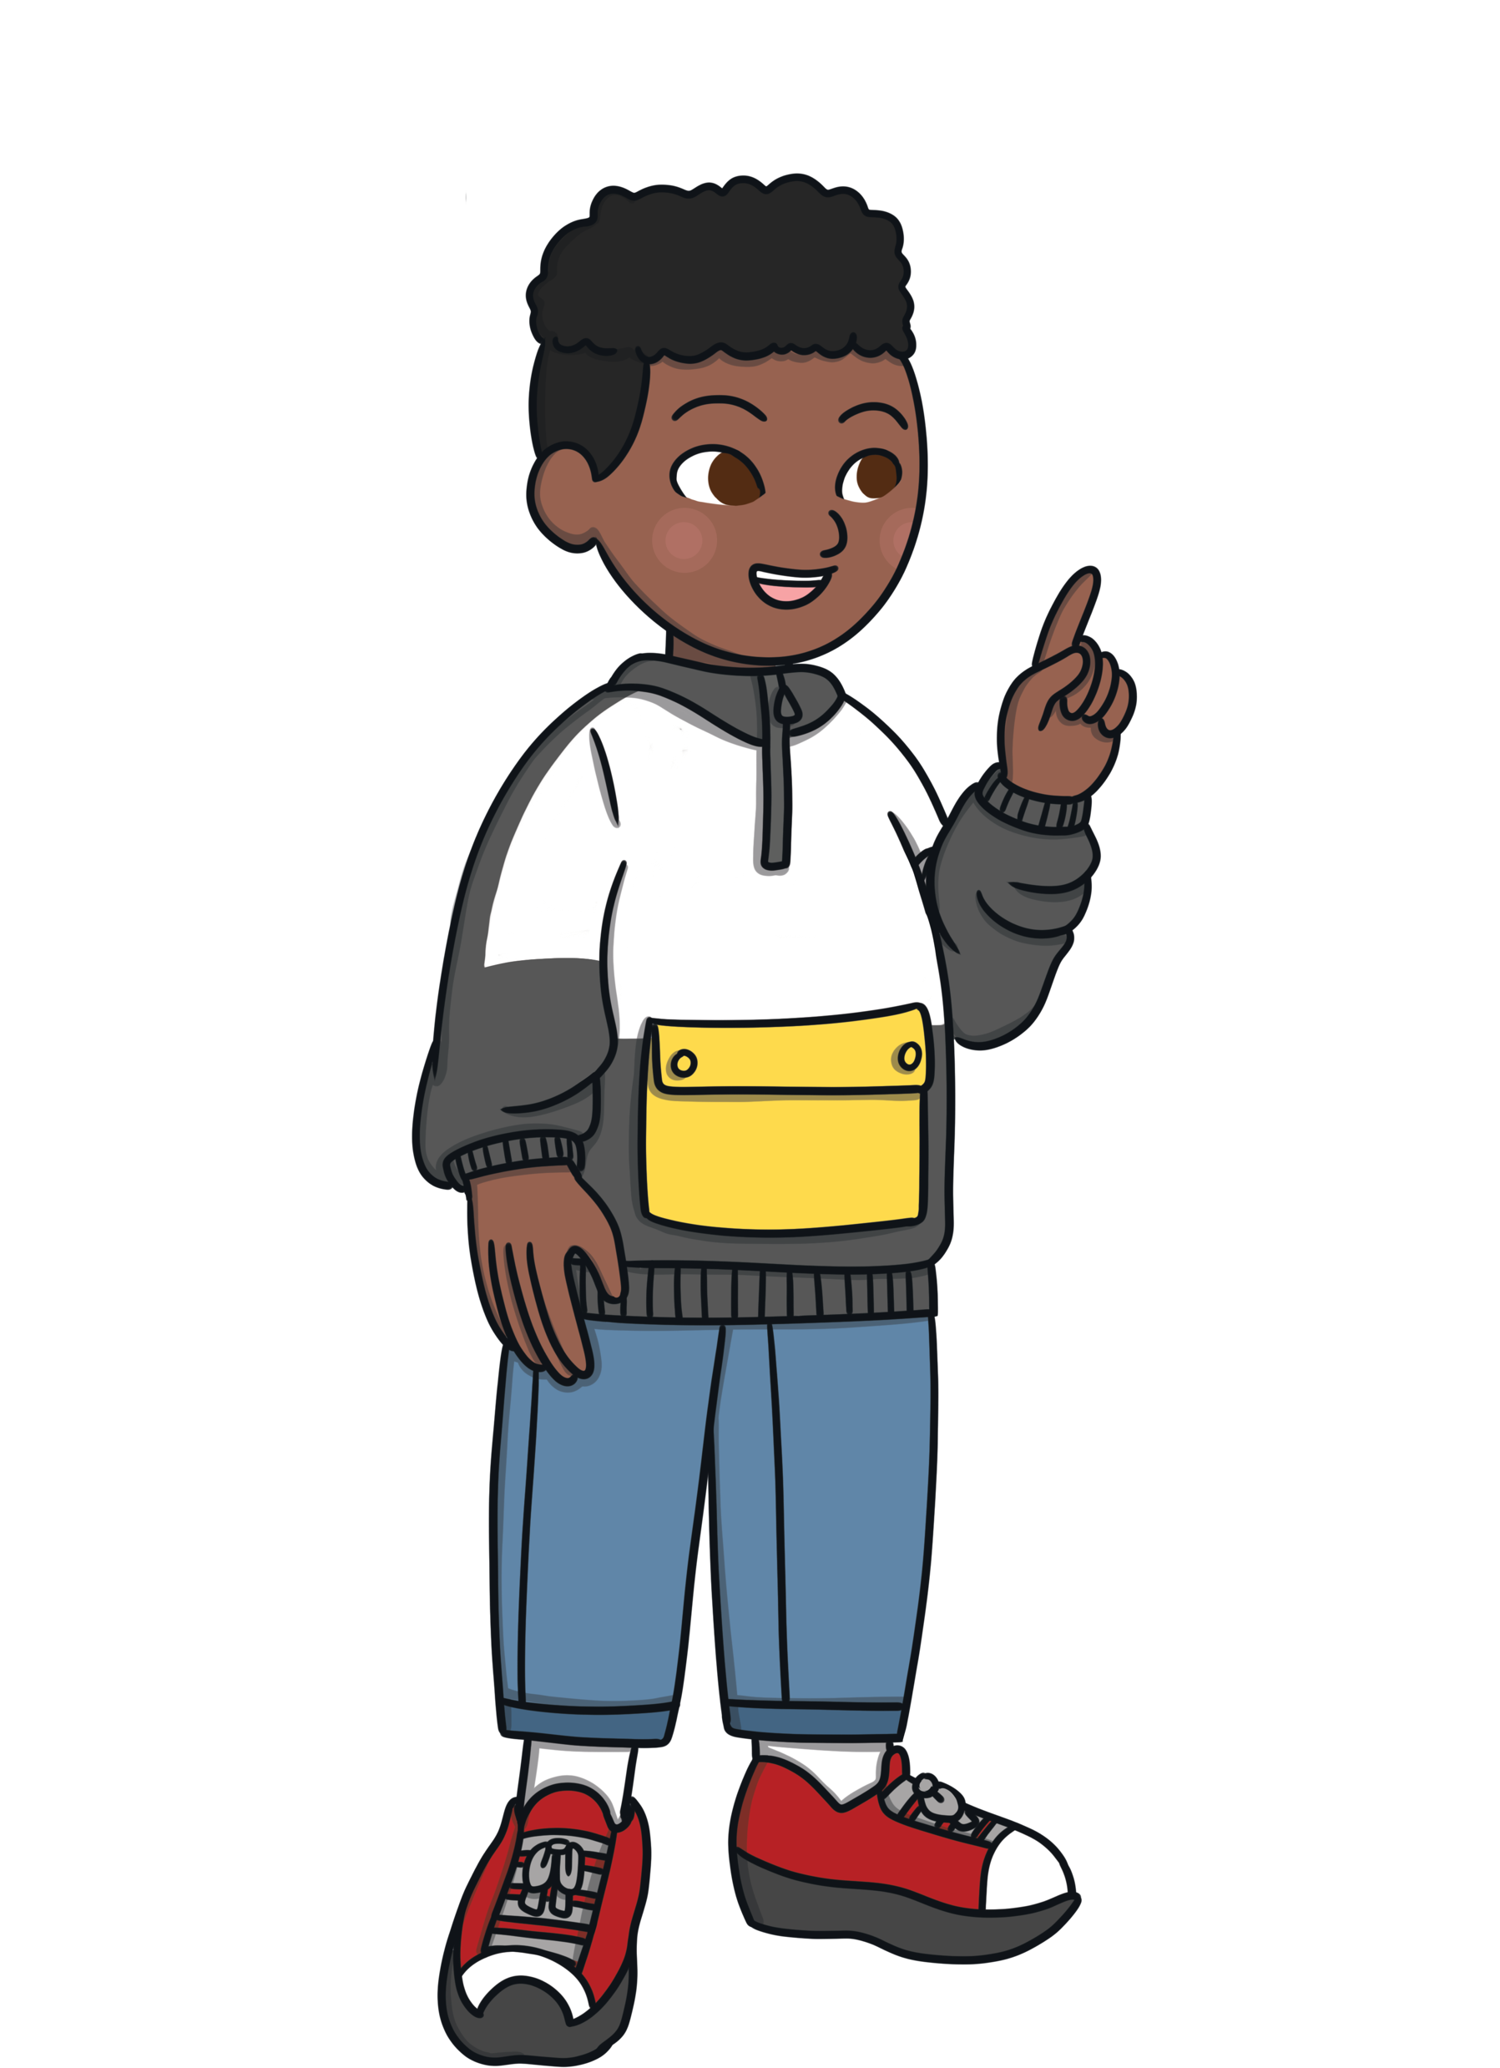



These children are talking very fast and squeezing together some of their words. Can you change the words that have apostrophes in them so that they are saying two words rather than one?
I won’t ride a skateboard. I’m scared of falling off.
I will not ride a skateboard. I am scared of falling off.
Don’t worry, it’s easy. I’ll show you how.
Do not worry, it is easy. I will show you how.
Do you think we’ll be taller next year?
Do you think we will be taller next year?
Yes, we’re growing all the time!
Yes, we are growing all the time!
Show answers
Can you write down your own conversation between two children using contractions with an apostrophe to show missing letters?

Slide 5



These words are being chopped up on the chopping board to remove the letters that are not needed. The letters that are replaced with apostrophes go into the trash can. Can you work out what the finished words will be and which letters go in the trash can?
there is
there‘s
have not
he had
he‘d
they will
haven’t
I am
they’ll
i
a
I'm
h
a
Can you write a sentence using each of the words that are on the plates?
w
i
o
Can you complete this sentence using letters that have been put in the bin?
The d_g _s smelly bec_use _e doesn’t l_ke to __sh.
Show answers
o
i
a
h
i
a
w

Slide 6
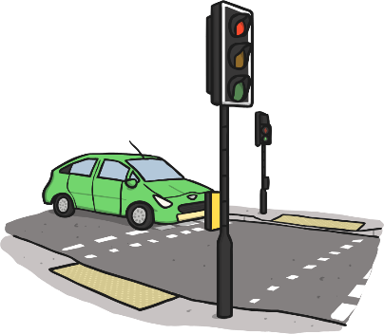
Can you rewrite the sentences so that each one includes an apostrophe to show missing letters in a contracted word? The first one has been done for you.
Ella did not like what her dad had packed for her lunch.
Ella didn’t like what her dad had packed for her lunch.
My little sister had not ever been to the beach before.
Let us wear our new clothes to the party.
You must not cross the road until the green light is showing.
We would love to come to your house for dinner.
She is the smartest girl in the class.
We should not be unkind to other children in the playground.
They had worked hard all day, so they deserved a rest.
My little sister hadn’t ever been to the beach before.
Let’s wear our new clothes to the party.
You mustn’t cross the road until the green light is showing.
We’d love to come to your house for dinner.
She’s the smartest girl in the class.
We shouldn’t be unkind to other children in the playground.
They’d worked hard all day, so they deserved a rest.
Show answers

Slide 7
Split into two teams. Take turns deciding which word uses an apostrophe to show missing letters correctly. If a team choose correctly, they get a point. If they choose incorrectly, the other team gets a point.
Which is correct?
wheres’
where’s
shoul'dnt
shouldn't
won’t
wo’nt
I’d
Id’
hel’l
he’ll
couldn't
could’nt
Can you use each of the correct words in a sentence?

Slide 8
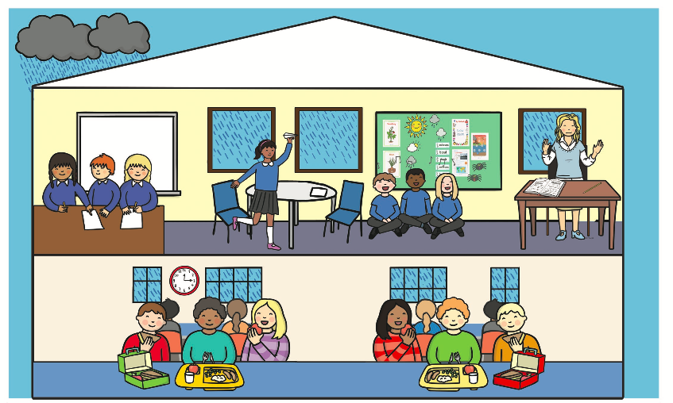
Can you write what you think each of these people are saying using a contraction with an apostrophe to show missing letters?
Who’ll make paper airplanes with me?
Aren’t we singing beautifully, Mrs. Smith?
What neat handwriting you’ve got.
You’re definitely getting better at that song!
I’ve already eaten all my lunch, now I’m eating my fruit.
It’s hot dogs for lunch today. That’s why Thursday is my favorite day of the week!
Show example answers

Slide 9


Let’s play "Ten Strikes and You’re Out!" Click on the letters that you think are missing to try to make the contracted word in the sentence. Every time you guess a letter incorrectly, press the "Uh-oh" button to make a pin disappear! Can you guess all of the missing letters before you strike out?
You need to hurry up, I _____’_ got all day!
Uh-Oh!
a
b
c
d
e
f
g
h
i
j
k
l
m
n
o
p
q
r
s
t
u
v
w
x
y
z

Slide 10
Let’s play ‘Ten Strikes and You’re Out!’ Click on the letters that you think are missing to try to make the contracted word in the sentence. Every time you guess a letter incorrectly, press the ‘Uh-oh’ button to make a pin disappear! Can you guess all of the missing letters before you strike out?
Today __’_ raining cats and dogs.
Uh-Oh!
a
b
c
d
e
f
g
h
i
j
k
l
m
n
o
p
q
r
s
t
u
v
w
x
y
z

Slide 11
Let’s play "Ten Strikes and You’re Out! " Click on the letters that you think are missing to try to make the contracted word in the sentence. Every time you guess a letter incorrectly, press the "Uh-oh" button to make a pin disappear! Can you guess all of the missing letters before you strike out?
I wanted to do P.E. but I ______’_ find my P.E. uniform.
Uh-Oh
a
b
c
d
e
f
g
h
i
j
k
l
m
n
o
p
q
r
s
t
u
v
w
x
y
z

Slide 12
Let’s play "Ten Strikes and You’re Out! " Click on the letters that you think are missing to try to make the contracted word in the sentence. Every time you guess a letter incorrectly, press the "Uh-oh" button to make a pin disappear! Can you guess all of the missing letters before you strike out?
I think ___’_ make a great scientist.
Uh-Oh!
a
b
c
d
e
f
g
h
i
j
k
l
m
n
o
p
q
r
s
t
u
v
w
x
y
z

Slide 13
Let’s play "Ten Strikes and You’re Out! " Click on the letters that you think are missing to try to make the contracted word in the sentence. Every time you guess a letter incorrectly, press the "Uh-oh" button to make a pin disappear! Can you guess all of the missing letters before you strike out?
This show is unbelievable! I wonder ____’__ happen next.
Uh-Oh!
a
b
c
d
e
f
g
h
i
j
k
l
l
m
n
o
p
q
r
s
t
u
v
w
x
y
z

Slide 14
Let’s play "Ten Strikes and You’re Out! " Click on the letters that you think are missing to try to make the contracted word in the sentence. Every time you guess a letter incorrectly, press the "Uh-oh" button to make a pin disappear! Can you guess all of the missing letters before you strike out?
We did a race to find out ___’_ the fastest runner in the class.
Uh-Oh!
a
b
c
d
e
f
g
h
i
j
k
l
m
n
o
p
q
r
s
t
u
v
w
x
y
z

Slide 15
Split into two teams. Take turns clicking on two cards. If you find a pair of cards that go together, then your team gets a point. The team with the most points wins! If they don't match, click on the cards to turn them back over.
is not
?
they’ve
?
were not
?
wouldn’t
?
you’ll
?
?
isn’t
?
you had
would not
?
weren’t
?
?
you will
?
they have
you’d
?

Slide 16


